Slide 1
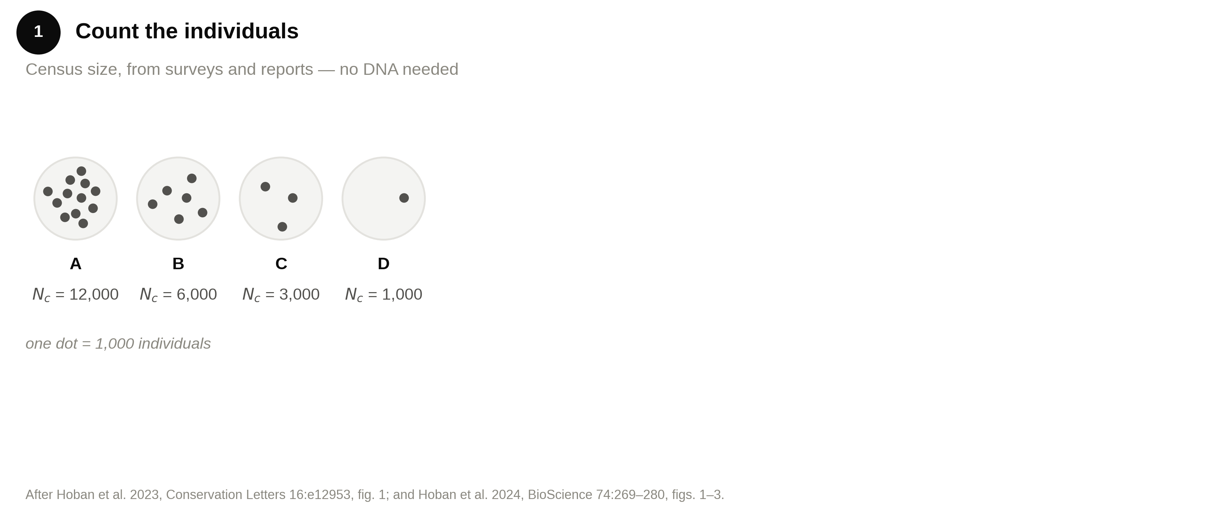
The global indicator is a headcount

Slide 2
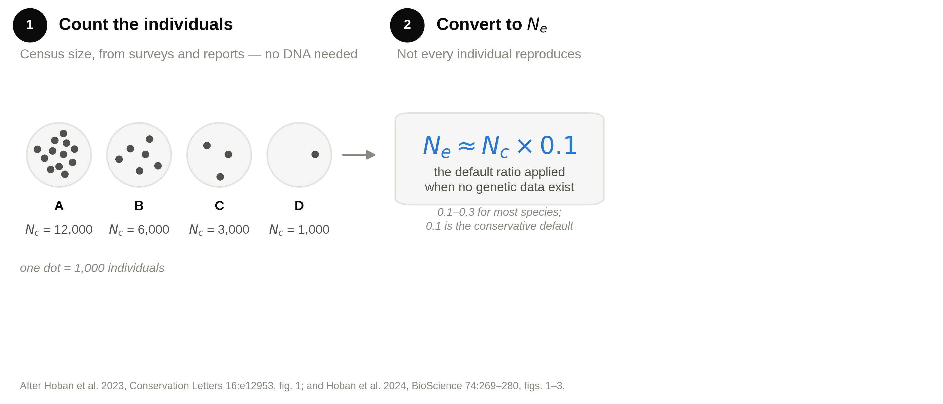
The global indicator is a headcount

Slide 3
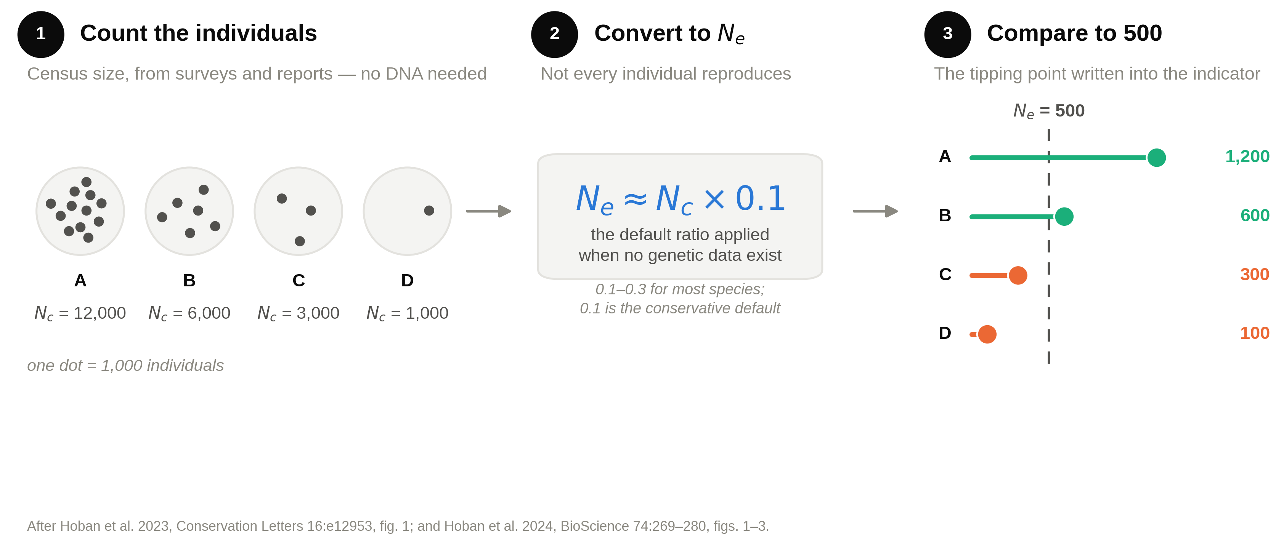
The global indicator is a headcount

Slide 4
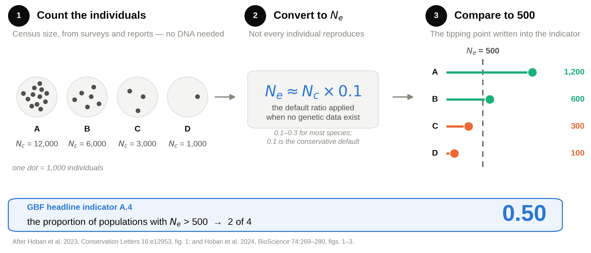
The global indicator is a headcount

